Slide 1



Slide 2


Has COVID-19 impacted the cost of living in New Zealand?

Slide 3
Reasons for choosing the impact of Covid-19
This subject is very topical
Relevant to all our lives
The data is very accurate due to it being it being under extreme scrutiny
The data is readily available from trusted sources

Slide 4
Data Acquisition
We used Stats New Zealand’s API to gather current Covid Data and shipping costs in and out of New Zealand
Downloaded CSV data that includes the Consumer price index

Slide 5
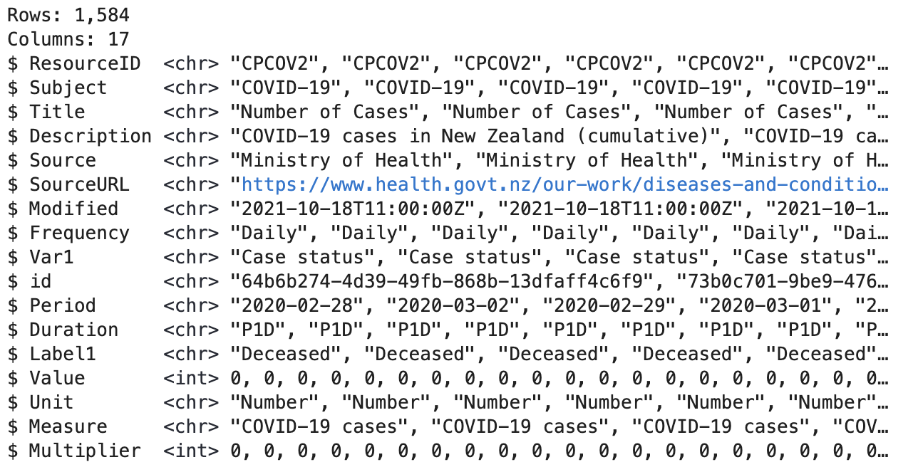
COVID 19 Indicators Dataset Raw

Slide 6
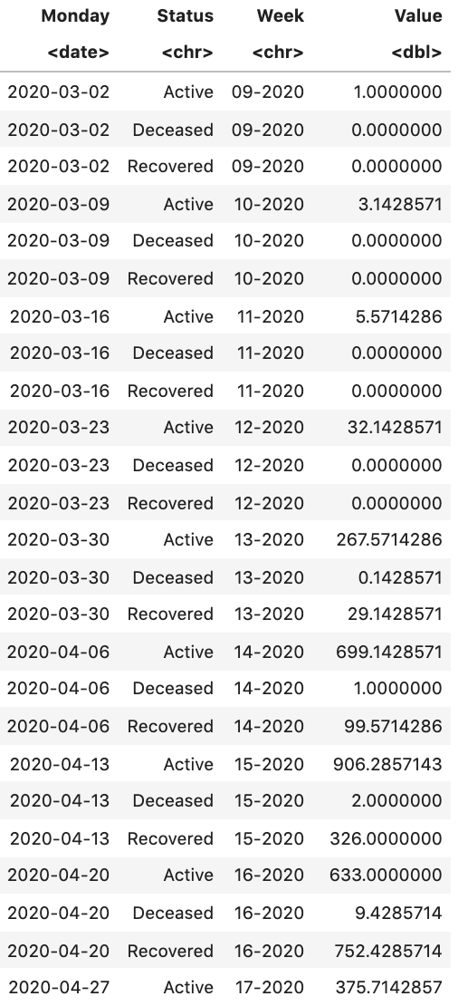
COVID dataset wrangled

Slide 7
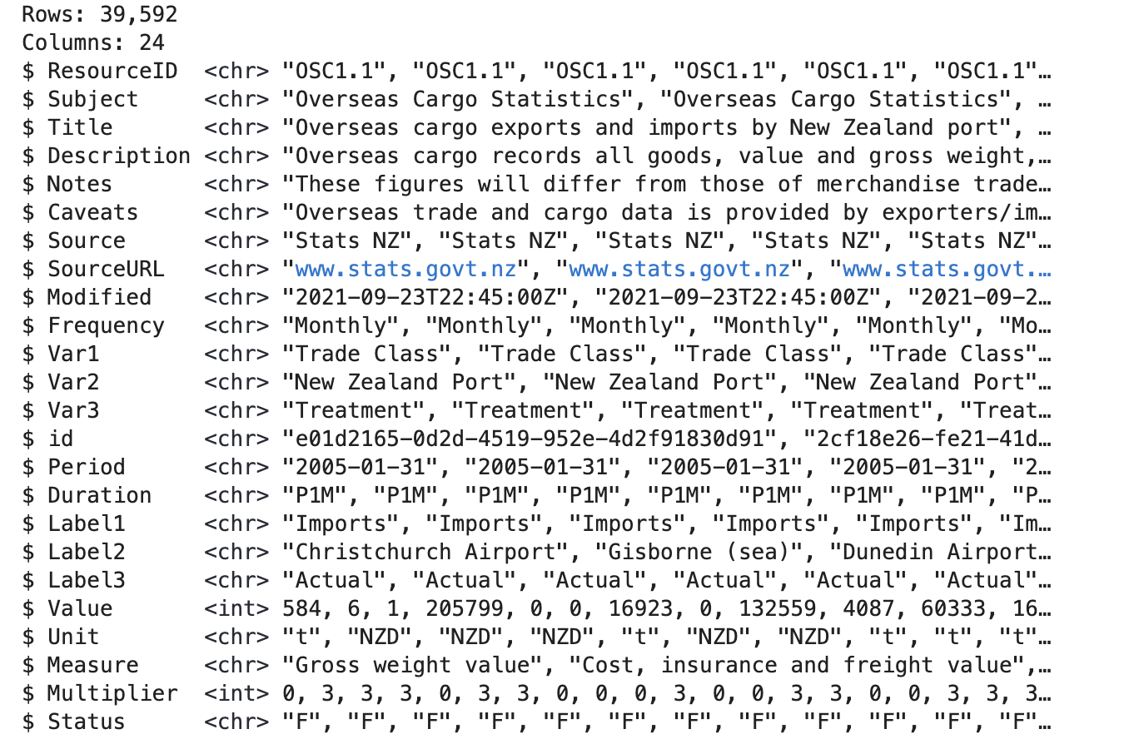
Overseas Cargo Raw

Slide 8
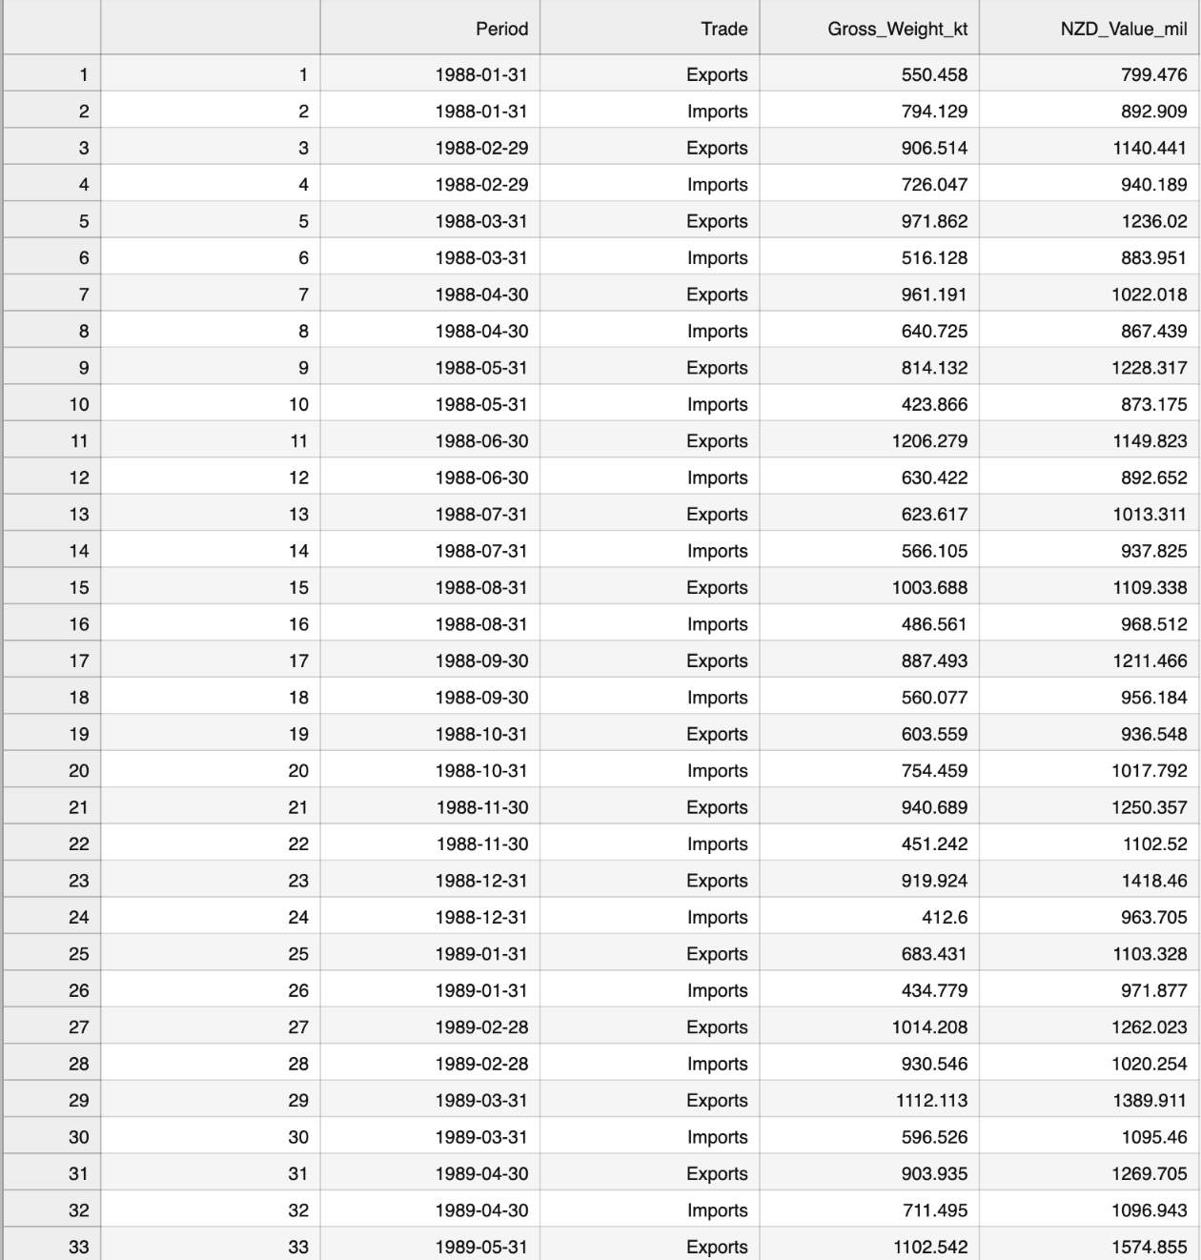
Overseas Cargo dataset Wrangled

Slide 9
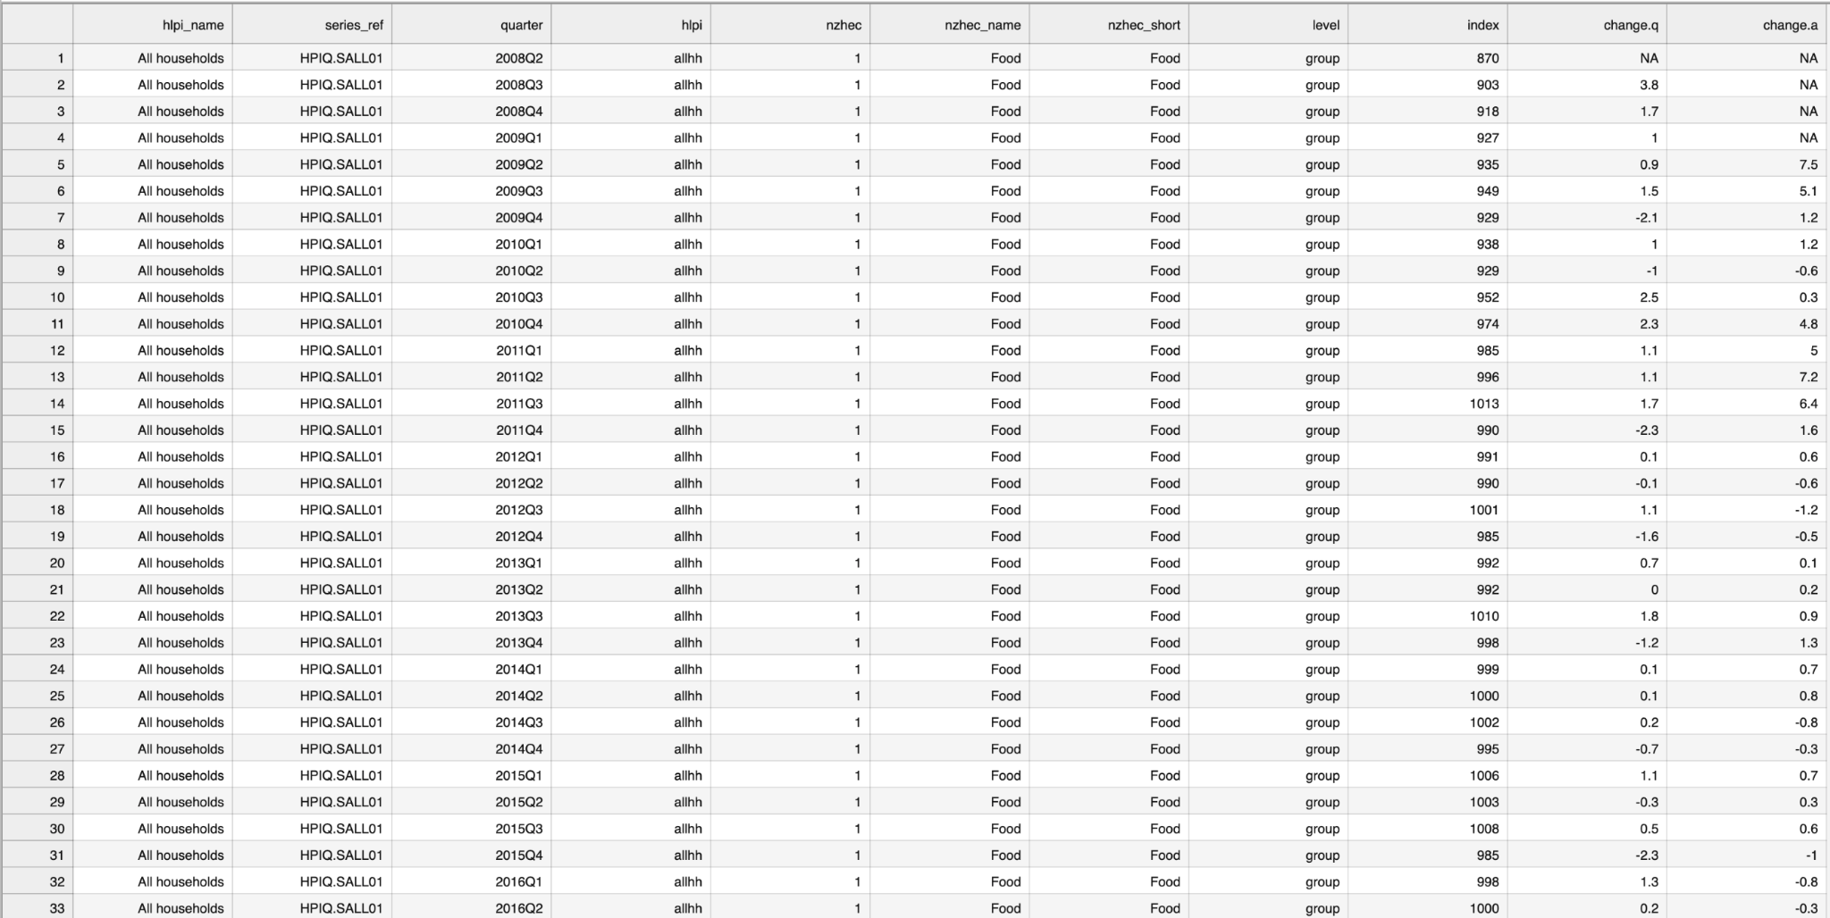
CPI dataset raw

Slide 10
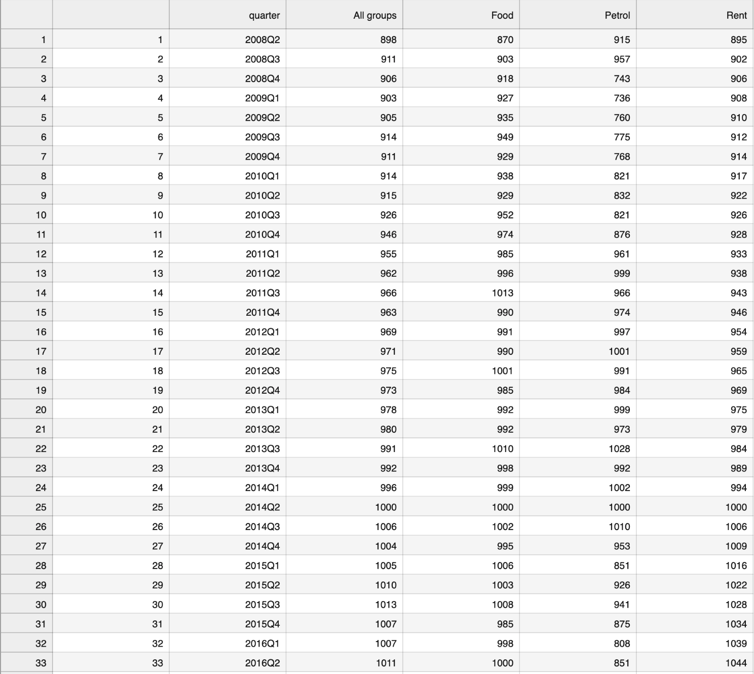
CPI dataset wrangled

Slide 11
Results

Slide 12
Difficulties
Confusing Raw Data
Information regarding data was limited
Import/Export Graphs hard to interpret
Date conversion of COVID dataset
Rows of missing data

Slide 13
Conclusion
Economic Recovery plan
2020 Russia–Saudi Arabia oil price war
Worldwide Shipping Backlog
COVID Rent amnesty
Too early to tell - Future data may reveal more

Slide 14


